Slide 1

Social Change
&
The Mass Media
By Dominic Tribelli

Slide 2
What is Social Change?
Social Change can be explained by the phrase; “Give a man a fish you feed him for a day, teach a man to fish you feed him for a lifetime.”
Social Change is a theory of leadership that calls for educating and empowering others, teaching others and giving them the power to help themselves and ultimately improving and benefiting the lives of others. It is philosophized to confront a problem rather than putting a bandage on it (e.g. relief programs where money is thrown to a victim without and guidance or education on how to take care of themselves or spend that money)
Assembling a group with a purpose and goal of positive change in a community
Social Change calls for working in a group and individual and group development as a result of this kind of involvement

Slide 3
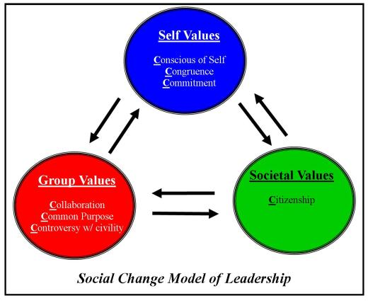
The Social Change Model
There are three domains of the model; individual, group, and society. Each domain contains values, or characteristics known as the seven “C’s.” These characteristics are all necessary for social change to take place.
The values required in an individual (the first three C’s) are congruency, commitment, and a consciousness of self
The values of an individual are required in order to successfully work with others and then subscribe to group values (the next three C’s) which are collaboration, common purpose, and a controversy with civility.
The values of a group are met only when they reach the society value, which is the last “C” of the model, and is citizenship
With all these C’s comes change, and the movement of social change can be applied!

Slide 4



Social Change in Our Community
On campus; all kind of clubs, organizations, fraternities, sororities, and social groups.
  Mentoring groups, etc.
Groups doing community service and other social change movements
General membership improves the lives of others through a development of character by involvement

Slide 5
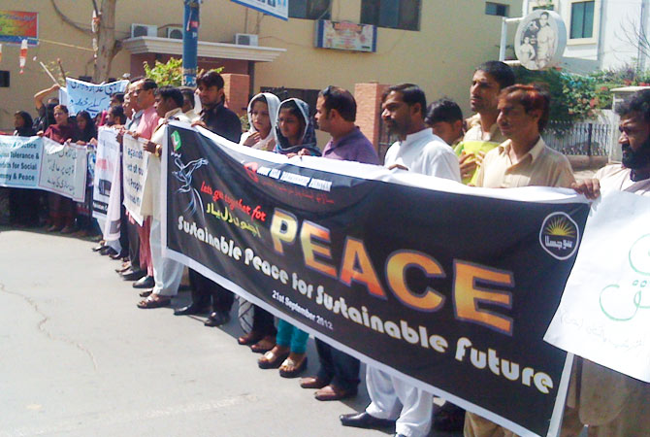
Social Change in the Media
Frankly Social Change is very under-reported
Although Social Change is everywhere in the community, it is never highlighted on the news when it comes to Social Change movements and activities.
Instead the media is full of advertisements for products, sports, celebrities, and MTV
The News is full of political events and other horror stories, more so than positivity and improving lives

Slide 6


What I did
I created a Facebook Page as an informative site for others to view and respond to, educating them about the theory of social change, how it works and why it is useful. With how Facebook works, I was able to invite friends to view and “like” the page.
  http://www.facebook.com/mysocialchange
I had previously created a personal website necessary for my material in the Leadership Studies Minor here at URI, and I had a page for my Facebook page link and some words describing my project for JOR 110H
  http://www.dominictribelli.yolasite.com

Slide 7


My Mission
The purpose of my project is to inform and inspire others of this theory of social change. I wish to educate others and remind them that everyone has the power to make a difference in their own lives, and someone else’s life. Everyone can make a difference in leading a cause, taking charge, and having the power to stand up for belief.

Slide 8
Works Cited
Vincent, Robert. "Leadership and Social Change." Personal interview. 14 Dec. 2012.
"What Is Social Change?" What Is Social Change? Fund For Southern Communities, n.d. Web. 15 Dec. 2012.
"Social Justice Leadership." Vision and Theory of Change. N.p., n.d. Web. 15 Dec. 2012.

